Slide 1
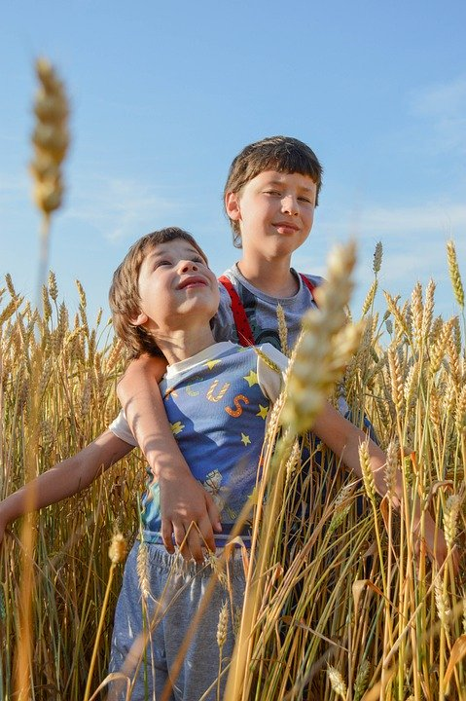
Zoom Family Worship
Happy Lammas
Notes:
Publicity slide only

Slide 2
Zoom Family Worship
It would be helpful if you had the following available for this session:
Some wheat (or a picture of wheat)
Bread to taste
1 cupful of plain flour
half a cupful of table salt
half a cupful of water
mixing bowl & apron etc
Happy Lammas
Notes:
At the beginning 5 minutes before we start – The video should start in click sequence and the music should also start automatically at the same time. You might hear the audio before you see the video counting down, it takes a few seconds…

Slide 3

The Lord is Here
His Spirit is with Us
Lift up your hearts
We lift them to the Lord
Worship

Slide 4
Worship – Praise to the Lord the Almighty
Notes:
Andrew to insert

Slide 5
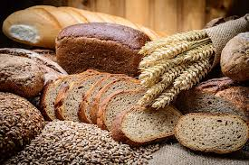
Happy Lammas
Notes:
Share (and taste) what you have which is made from wheat

Slide 6

We confess
Lord have mercy
Christ have mercy
Notes:
Short confession

Slide 7
INTRODUCING THE LIGHTWAVE RURAL CHAPLAIN
Notes:
Andrew to insert video

Slide 8
QUESTIONS FOR THE LIGHTWAVE RURAL CHAPLAIN
Notes:
Interview

Slide 9
Wheat and the Tares
Notes:
Andrew to insert video

Slide 10
Making Salt Dough
Notes:
Making salt dough is a really fun and easy activity for kids and the chances are you will have all of the ingredients in the cupboard ready to go Children will love using their imaginations to create all sorts of exciting objects (although simple shapes do seem to work best) and hours of fun painting their creations, but do take care to remind little ones that the salt dough is not edible.
Makes 1 ball
Prep 10 minutes
1 cupful of plain flour (about 250g)
half a cupful of table salt (about 125g)
half a cupful of water (about 125ml)
Method
1. Preheat the oven to its lowest setting and line a baking sheet with baking parchment.
2. Mix the flour and salt in a large bowl. Add the water and stir until it comes together into a ball.
3. Transfer the dough to a floured work surface and shape into your chosen model. You can roll it out and cut out shapes, numbers or letters using biscuit cutters, or make any kind of model you can think of. We suggest making “food” as you play some quiet music and praying for those who are hungry.
4. After the service you could put your finished items on a lined baking sheet and bake for 3 hrs or until solid.
5. Leave to cool and then paint.

Slide 11
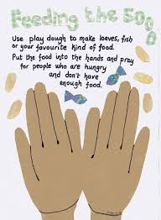
Pray dough
Notes:
Explain how you can use the salt dough to make the shape of your favourite food and pray for those who are hungry.
Quiet music plays while people do this.

Slide 12
Farmers’ Prayers
Notes:
Andrew to insert video(s) from Allister and/or Graham

Slide 13
Lord’s Prayer
Our Father who art in heaven, hallowed be Thy name
Thy Kingdom Come,
Thy will be done on earth as it is in heaven
Give us this day our daily bread
And forgive us our trespasses as we forgive those who trespass against us
And lead us not into temptation but deliver us from evil.
For Thine is the Kingdom, the power and the glory
For ever and ever. Amen
Notes:
Graham to lead

Slide 14
Worship – Let everything that has breath
Notes:
Andrew to Insert song Let everything that

Slide 15
Lammas Blessing
Notes:
All but leaders muted initially to allow for the event to conclude. Remain in gallery mode (no powerpoint so we can see each other).
Play The UK Blessing Video (Next Slide). Video will start automatically as soon as NEXT side is displayed

